Slide 1
SWOT Analysis
Brainstorming to identify our strengths and weaknesses, opportunities and threats.

Slide 2
Introduction
The objective of this task is to create a co-educational and inclusive environment as part of the STEAM-Labs.
As teachers, our work will consist of analyzing and proposing actions to ensure co-educational and inclusive practices in the STEAM-Labs.
Put your names in this post-its

Slide 3
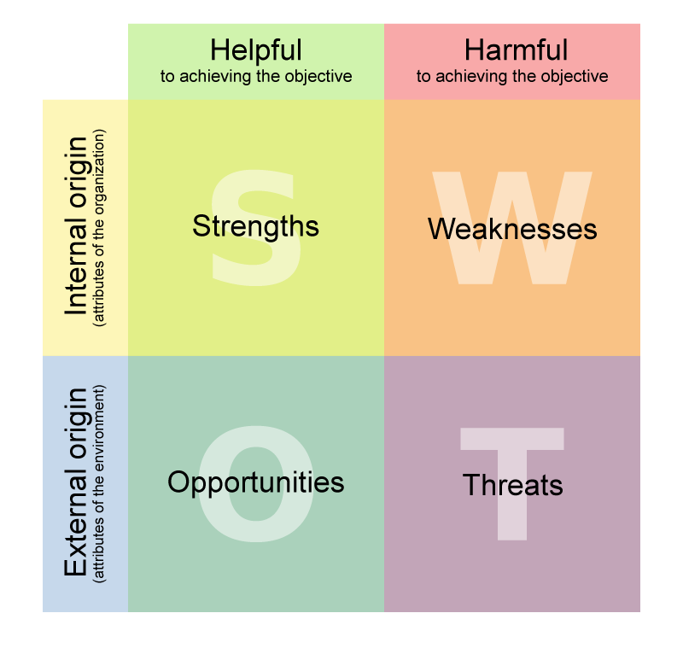
Let's go there!

Slide 4
SWOT Analysis
1
Give it some thought.
2
Write your ideas in the notes. Check the headings to make sure you place the notes in the correct section.
SWOT stands for Strengths, Weaknesses, Opportunities, Opportunities and Threats.
Based on the dynamics of the group and its objectives, the SWOT analysis allows us to focus on the aspects that can help us to reinforce our strengths, resolve our weaknesses, take advantage of opportunities and address threats.
Idea 1
Idea 2
Idea 3
Idea 4
3
Use stars to vote or add a reaction to each of the ideas.

Slide 5
COEDUCATIONAL OBSERVATION SHEET
CENTRE ORGANISATION
In the governing bodies: What is the number of men and women who make up the educational institution's governing bodies? What tasks do women and men assume in the performance of the functions of each body?
At meetings: How is each intervention evaluated according to the gender/cultural background/etc of the speaker? What criteria are used to order the proposals to be discussed? How long does each person speak?
In the documents of the Centre: From what educational principles are documents drafted (Study Plans, Academic Guides…)?
If you have the opportunity to know the institution's budget, which budget items are related to equality and inclusion?
Relationships: How are the relationships between all the people who form part of the educational community: students, teachers, parents? Do they transmit listening, communication, dialogue...?

Slide 6
Strengths
Write your ideas here.
What strengths we can find?
Notes:
Fortalezas

Slide 7
Weaknesses
Write your ideas here.
Where are we failing, where can we improve?
Notes:
Debilidades

Slide 8
Opportunities
Write your ideas here.
What could we get more out of? What trends could we take advantage of?
Notes:
Oportunidades

Slide 9
Threats
Write your ideas here..
What is stopping us?
Notes:
Amenazas

Slide 10
Write your ideas here.
Write your ideas here.
Write your ideas here.
Write your ideas here..

Slide 11
Measures
1
Write the relevant measurements in the notes.
Write your ideas here.
…
..
...

Slide 12
Thank you for your participation!
Co-education

